Slide 1

Nutrition
Lecture 1
VNSG 1577
Concept Based Nursing Care I

Slide 2
References:
Maternal / Child Text:
  Dietary needs of Pediatric
  Breastfeeding / Bottle Feed
  Fundamentals Text Chpt 23/24: Dietary needs of Adult
  Dietary categories
  Dangers of PICA
  Reading nutrition labels
  Malnutrition
  Obesity
  Starvation
  Dental Health
  Dysphagia / Swallow test
  Iron Deficiency Anemia
  Scurvy
  Rickets
Maternal / Child Text:
  Dietary needs of Pediatric
  Pg 270-276 / Pg 276-280
  Care of Older Client Text:
  Pg 114-127 Older Client
  Dietary categories
  Reading nutrition labels
  Malnutrition
  Obesity
  Starvation
  Dental Health
  Dysphagia / Swallow test
  Iron Deficiency Anemia
  Scurvy
  Rickets
VNSG 1577 NURG Care 1 Wk 3

Slide 3
NUTRITION Overview
The study of nutrients and how they are utilized in the human body
Nutrients are specific biochemical substances used by the body for:
  growth and development
  activity
  reproduction
  lactation
  health maintenance
  recovery from illness
  repair of injury
VNSG 1577 NURG Care 1 Wk 3

Slide 4
Basal Metabolic Rate (BMR)
Energy required to carry on the involuntary activities of the body at rest such as:
  Maintaining body temperature/muscle tone
  Producing and releasing secretions
  Moving food through GI tract
  Inflating lungs
  Contracting heart muscle
Measures the body’s consumption of O2 & therefore the rate of calories burned when the body maintains basic metabolic activities
VNSG 1577 NURG Care 1 Wk 3

Slide 5
Basal Metabolic Rate (BMR)
Growth, infections, fever, emotional tension, extreme environmental temperatures and elevations of certain hormones can increase BMR
Aging, prolonged fasting and sleep decrease BMR
  Higher BMR- the more calories the client can take in without weight gain
  Men have higher BMR than women due to larger muscle mass
  BMR decreases 2% during each decade after age 30
VNSG 1577 NURG Care 1 Wk 3

Slide 6
Body Mass Index
Body mass index
(BMI) is calculated to measure body fat and used along with waist-to-hip ratio measurements to determine the patient’s health risk factors (Table 32.4).
Assesses relative weight for height.
It provides a range with which to evaluate a healthy body (18.5- 24.9)
It doesn’t reflect body composition (>muscle mass may appear overweight)
VNSG 1577 NURG Care 1 Wk 3
Notes:
Page 618 Med Surg text
Height, Weight, and Body Mass Index
The patient’s height and weight are obtained for planning care. Excess waist circumferences (for women, more than 35 inches; for men, more than 40 inches) place people at greater risk for diabetes and cardiovascular disease. Body mass index (BMI) is calculated to measure body fat and used along with waist-to-hip ratio measurements to determine the patient’s health risk factors (Table 32.4).
To calculate body mass index (BMI)Formulas:
Pounds and inches: weight (lb) / [height (in.)]² × 703
Step 1. Multiply height (in inches) by height.
Step 2. Divide weight (in pounds) by Step 1 answer.
Step 3. Multiply Step 2 answer by 703.
Kilograms and meters: weight (kg) / [height (m)]²
Step 1. Multiply height (in meters) by height.
Step 2. Divide weight (in kilograms) by Step 1 answer.

Slide 7
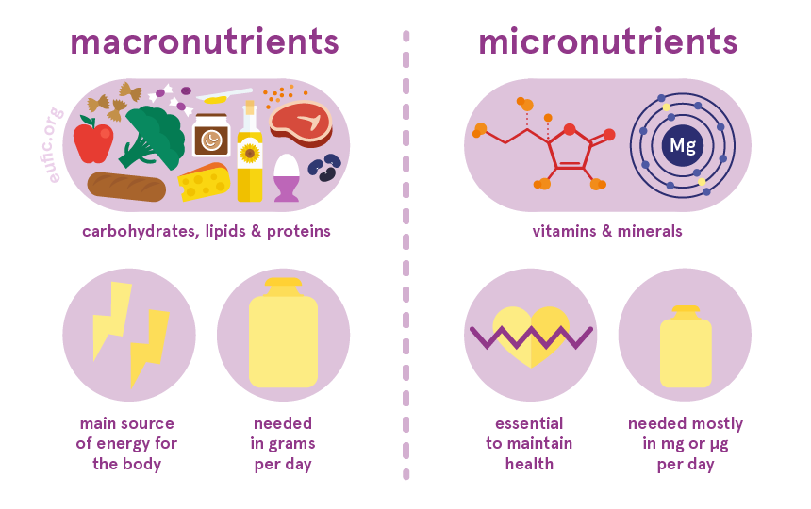
VNSG 1577 NURG Care 1 Wk 3

Slide 8
Essential Nutrients
Macronutrients
Nutrients that aide in supplying energy & build tissue
  Carbohydrates
  Protein
  Fats (Lipids)
  Water
VNSG 1577 NURG Care 1 Wk 3

Slide 9
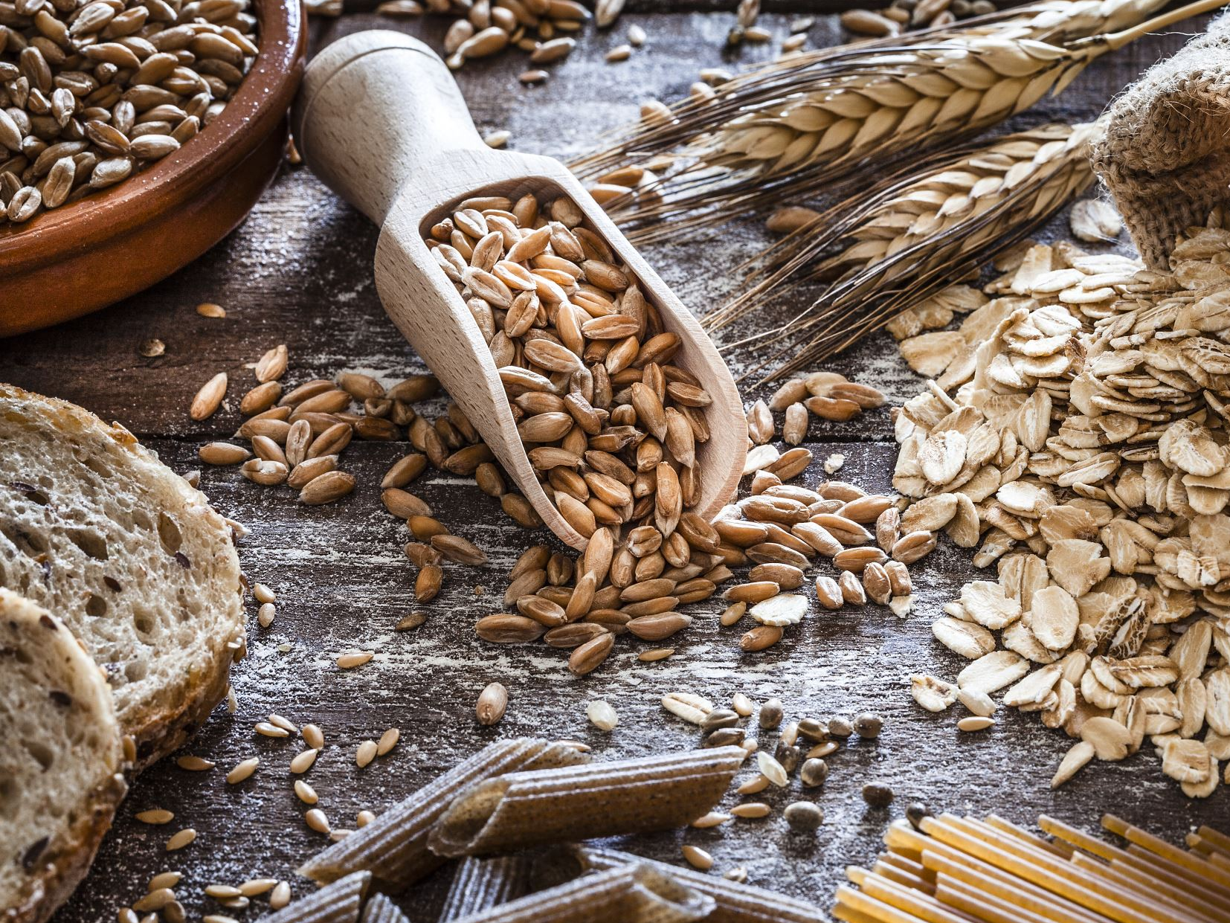
Carbohydrates (CHOs)
Plays role in the following:
  Structural role
  Energy role
  Cellular role
Building blocks-monosaccharide
  Disaccharides
  Complex polysaccharides
  Starches
Food sources- Natural sugars, Refined sugars, added carbohydrates (modified starch thickeners, HFCS, sugar substitutes), vegetables and grains
VNSG 1577 NURG Care 1 Wk 3
Notes:
Complex Carbs: Whole grains, beans, quinoa, legumes, oats, and brown rice
Simple Carbs: Raw sugar, Brown sugar, Corn syrup/high-fructose corn syrup, Fruits (naturally occurring sugars), Vegetables (naturally occurring sugars), Milk and milk products, (naturally occurring sugars), Honey
Good Carbs: vegetables, low glycemic fruits such as berries and apples, as well as legumes and unprocessed high fiber whole grains.
Bad Carbs: chips, cookies, sodas, bagels, cake, pastries, pancakes, soda, high fructose corn syrup and baked goods.
Disaccharides (lactose): milk, dairy products / disaccharides are simple sugars soluble in water. Three common examples are sucrose, lactose, and maltose. Disaccharides are one of the four chemical groupings of carbohydrates.
Complex polysaccharides: consist of hundreds or even thousands of monosaccharides. They include starch, glycogen, cellulose, and chitin.
Starches: it is the chief storage form of carbohydrates in plants.
Food sources: Natural sugars (Natural sugars are found in fruit as fructose and in dairy products, such as milk and cheese, as lactose)
Refined sugars (Refined sugars are found in sugar cane or sugar beets, which are processed to extract the sugar. It is typically found as sucrose, which is the combination of glucose and fructose.)
Modified starch thickeners (modified starch thickeners include tapioca, cornstarch, and arrowroot.)
HFCS (High-fructose corn syrup, also known as glucose–fructose, fructose syrup, is a sweetener made from corn starch.)
Sugar substitutes (A sugar substitute is a food additive that provides a sweet taste like that of sugar zero-calorie or low-calorie sweetener.)

Slide 10
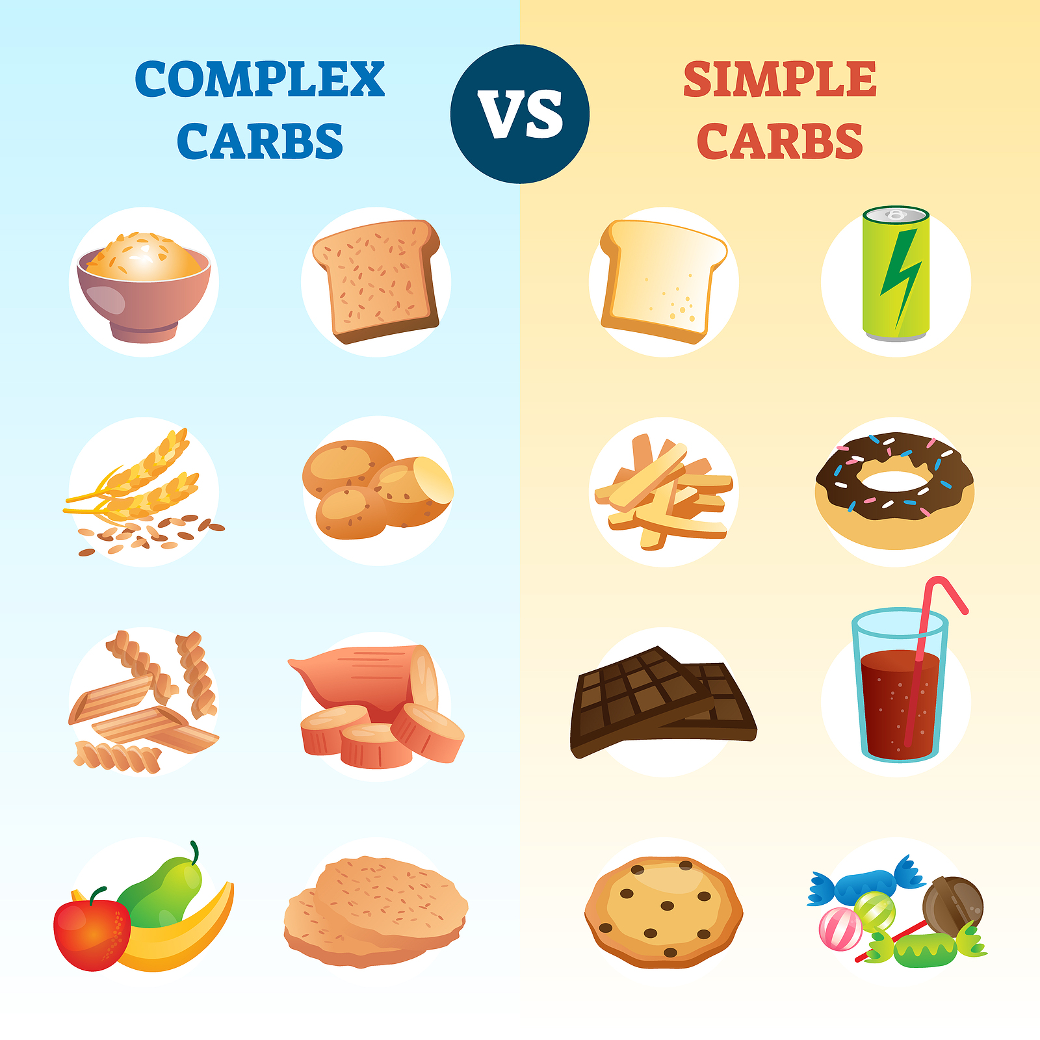
VNSG 1577 NURG Care 1 Wk 3

Slide 11
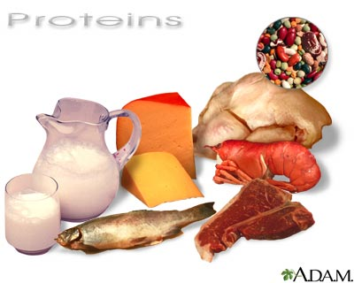
Proteins
Plays role in the following:
    Structural role
    Enzyme role
    Transport role
    Defense role
    Fluid and acid-base balance
Building block-amino acid
Food sources- animal sources & eggs, soy proteins (vegetarian diets)
VNSG 1577 NURG Care 1 Wk 3
Notes:
Amino acids are the building blocks of proteins and play an important role in body functions. They are needed for vital processes like the cell building and synthesis of hormones and neurotransmitters (brain chemicals).
Protein examples: meat, dairy, including milk, cheese and yogurt, and eggs. These are the most complete foods for essential amino acids. Fish is another example of a food with a high protein content.
Protein structural role: It helps repair and build your body's tissues, allows metabolic reactions to take place and coordinates bodily functions. In addition to providing your body with a structural framework, proteins also maintain proper pH and fluid balance.
Enzyme role: Digestive enzymes play a key role in breaking down the food you eat. These proteins speed up chemical reactions that turn nutrients into substances that your digestive tract can absorb. Your saliva has digestive enzymes in it. Some of your organs, including your pancreas, gallbladder, and liver, also release them.
Transport role: Transporting nutrients to the cells of your body is the job of your circulatory system. The circulatory system consists of your heart, blood and blood vessels. There are three types of blood vessels: arteries, veins and capillaries. Nutrients are transported throughout your body through your blood via capillaries, tiny blood vessels that connect arteries to veins.
Defense role: Protective nutrients benefit health in various ways beyond their conventionally established nutrient function such as by enhancing immune function, promoting gastrointestinal integrity, impacting metabolism, and preventing disease.
Fluid and acid-base balance: Electrolytes are minerals in your body that have an electric charge. They are in your blood, urine, tissues, and other body fluids. Electrolytes are important because they help
Balance the amount of water in your body
Balance your body's acid/base (pH) level
Move nutrients into your cells
Move wastes out of your cells
Make sure that your nerves, muscles, the heart, and the brain work the way they should
Sodium, calcium, potassium, chloride, phosphate, and magnesium are all electrolytes. You get them from the foods you eat and the fluids you drink.
The levels of electrolytes in your body can become too low or too high. This can happen when the amount of water in your body changes. The amount of water that you take in should equal the amount you lose. If something upsets this balance, you may have too little water (dehydration) or too much water (overhydration). Some medicines, vomiting, diarrhea, sweating, and liver or kidney problems can all upset your water balance.

Slide 12
Lipids (fats)
Plays role in the following:
  Structural role
  Transport role (Lipo proteins)
The four main groups of lipids include:
Building block- Fatty acids and Glycerides
Saturated/Unsaturated fats
Cholesterol
Triglycerides
Food sources- many plant & animal sources, hydrogenated fats, artificial fat products
VNSG 1577 NURG Care 1 Wk 3
Notes:
Structural role: They serve as regulatory agents in cell growth and adhesion.
Transport role: Lipids are insoluble in water (oils / fat), must be transported with proteins to deliver fatty acids
Lipid examples: Foods high in lipids include oils, meats, poultry, oily fish, chocolate, dairy, nuts and seeds, waxes, oils, sterols, cholesterol, fat-soluble vitamins, monoglycerides, diglycerides, triglycerides (fats), and phospholipids.
Good lipids activate genes that burn calories, increase metabolism and improve insulin activity.
Bad lipids have the opposite effect, slow metabolism and poor insulin activity.
Labs: Cholesterol or Lipid profile or lipid panel is a panel of blood tests that serves as an initial screening tool for abnormalities in lipids , such as cholesterol and triglycerides. Factors such as your age, sex, and genetics, lifestyle, including your diet, level of physical activity, level of diabetes control, and smoking status. Diabetes, hypothyroidism, alcoholism, kidney disease, liver disease and stress.
Total Cholesterol, Triglycerides, High Density Lipoproteins (HDL also called "good cholesterol"), Low Density Lipoproteins (LDL also called "bad cholesterol"), a ratio of Total Cholesterol to HDL and an estimated risk factor.

Slide 13
Essential Nutrients
Micronutrients
  Micronutrients are not produced in the body and must be derived from the diet. Six essential micronutrients:
    Iron
    Vitamin A
    Vitamin D
    Iodine
    Folate
    Zinc
VNSG 1577 NURG Care 1 Wk 3
Notes:
Iron: oxygen transport, energy production, DNA synthesis, Hemoglobin, myoglobin. Laboratory tests that measure serum ferritin (iron-storage protein), serum iron, total iron binding capacity (TIBC) , saturation of transferrin (the main iron carrier in blood),
Vitamin A: two types of vitamin A – retinol and beta-carotene. Regulates the immune system. It helps regulate the immune system by vitamin A may help lymphocytes, a type of white blood cell that fights infections, function more effectively.
Vitamin D: regulate the immune system and the neuromuscular system. Vitamin D also plays major roles in the life cycle of human cells. Vitamin D is so important that your body makes it by itself -- but only after skin exposure to sufficient sunlight.
Iodine: most important role is to ensure proper thyroid function. It helps to regulate the production of the thyroid hormones thyroxine (T4) and triiodothyronine (T3). Getting enough iodine is essential for preventing low thyroid hormone production and hypothyroidism.
Folate: Folate (vitamin B-9) is important in red blood cell formation and for healthy cell growth and function. The nutrient is crucial during early pregnancy to reduce the risk of birth defects of the brain and spine. USDA recommends that women of child bearing age consume 200mcg of folic acid a day.
Zinc: is essential for cell growth and division, immune function, enzyme reactions, DNA synthesis and protein production.

Slide 14
Minerals
Micronutrients
  Small molecule groups that are needed by the body to maintain normal physiologic functioning
  Nutrients that aide in regulation of body processes and are required in smaller amounts
    Vitamins, minerals and water
    Micronutrients can further be subdivided into
      Major Minerals
      Minor Minerals (Trace elements)
VNSG 1577 NURG Care 1 Wk 3

Slide 15
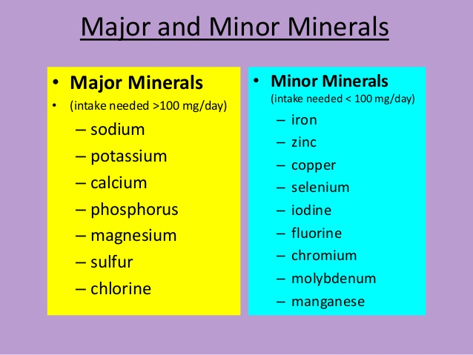
VNSG 1577 NURG Care 1 Wk 3
Notes:
The liver stores the minerals iron and copper; the fat-soluble vitamins A, D, E, and K; and the water-soluble vitamin B₁₂.
Major minerals: One of the key tasks of major minerals is to maintain the proper balance of water in the body. Sodium, chloride, and potassium take the lead in doing this. Three other major minerals—calcium, phosphorus, and magnesium—are important for healthy bones.
Minor minerals: building strong bones to transmitting nerve impulses. Some minerals are even used to make hormones or maintain a normal heartbeat.

Slide 16
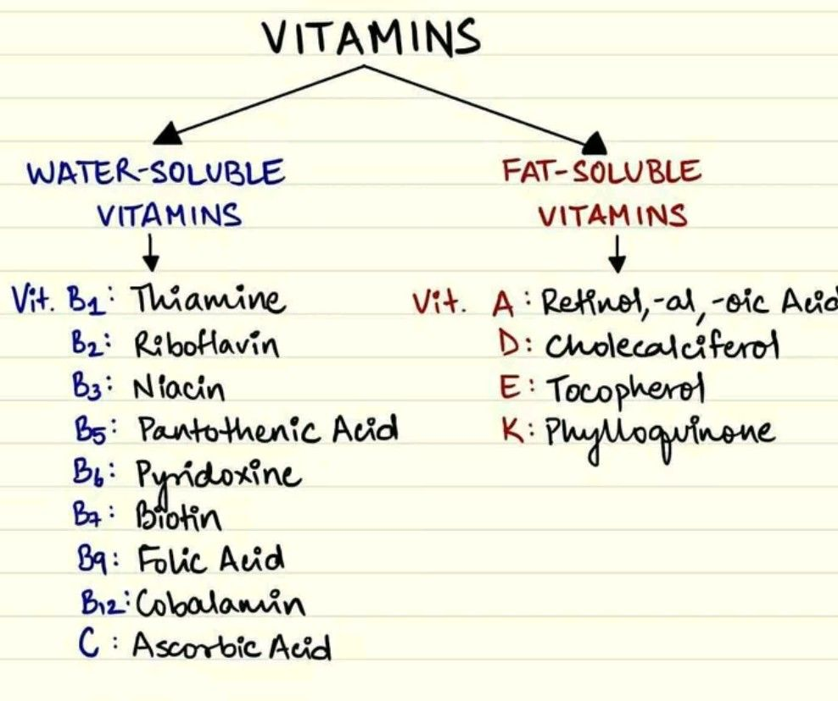
VNSG 1577 NURG Care 1 Wk 3
Notes:
Water-soluble vitamins: Water-soluble vitamins are carried to the body's tissues but are not stored in the body. Helps promote cardiovascular and eye health, and ward off wrinkles and the signs of aging skin. THIAMIN HCL (Vitamin B1) The body needs B1 to convert food into energy, and for DNA and RNA to work together.
Fat-soluble vitamins: The fat-soluble vitamins are A, D, E, and K. Being fat soluble means that they are absorbed in the lymph, are transported in the blood with carrier proteins, and they can be stored in the liver and fatty tissues.

Slide 17
Water
Box 23.6
Critical to sustain life
Every cell, tissue, organ, and body system depend on adequate water intake to function properly.
Adults 55-65%
Infants 65-70%
Need 6-8. 8 oz servings a day(more if sick or exercising)
VNSG 1577 NURG Care 1 Wk 3

Slide 18
Population Guidelines
Dietary Reference intakes (DRIs)
  Estimated Average Requirement (EAR)
  Recommended Dietary Allowances (RDAs)
  Adequate Intake (AI)
  Tolerable upper limits (UL)
Healthy People 2020 Initiative
Eating a well-balanced diet is the best way to meet all daily vitamin and nutrient needs
VNSG 1577 NURG Care 1 Wk 3
Notes:
Estimated Average Requirement (EAR): defined as the average daily nutrient intake that is estimated to meet the requirements of 50% of the healthy individuals in a life stage and gender group.
Recommended Dietary Allowances (RDAs): average daily level of intake sufficient to meet the nutrient requirements of nearly all (97%-98%) healthy people.
Adequate Intake (AI): The AI is a recommended average daily nutrient intake level, based on experimentally derived intake levels or approximations of observed mean nutrient intake by a group (or groups) of apparently healthy people that are assumed to be adequate.
Tolerable upper limits (UL): The highest level of nutrient intake that is likely to pose no risk of adverse health effects for almost all individuals in the general population. As intake increases above the UL, the risk of adverse effects increases.

Slide 19
Nutrition
LIFESPAN AND DEVELOPMENTAL CONSIDERATIONS
VNSG 1577 NURG Care 1 Wk 3

Slide 20
Preconceptual Nutrition
Nutrition status before conception & pregnancy
Course of pregnancy profoundly affected by nutritional status
Completely assess nutritional status and identify any alterations that may impact developing embryo/fetus
Monitor weight, adequate nutrition intake, deficiencies, vitamin intake.
VNSG 1577 NURG Care 1 Wk 3
Notes:
Page 103 Maternal Child text
Page 445 of the Fundamentals Text

Slide 21
Nutrition & Pregnancy
Increased metabolic needs
Nutrition & pregnancy related concerns:
  Nausea/vomiting
  Heartburn
  Physiological anemia of pregnancy
  Cravings and aversions
  Altered bowel patterns
  Fluid retention
  High risk pregnancies due to gestational diabetes, hyperemesis gravidarum, other preexisting maternal diseases
VNSG 1577 NURG Care 1 Wk 3

Slide 22
Nutrition & Pregnancy
Pregnancy:
Increased fluid intake
Nutritional state before pregnancy important
75 – 100 grams/day protein
Calcium 1200 mg/day
Increase iron-prenatal vitamins
Folic acid - prevent neural tube defects (600mcg/day)
VNSG 1577 NURG Care 1 Wk 3
Notes:
Page 104. I updated the protein and Folic Acid numbers. Those are wrong on your copy of the power point.

Slide 23
Nutrition & Pregnancy
  Lactation:
  500 kcal above pre-pregnant needs
  Infant diet consists: protein, fat, and carbohydrates via breastmilk
    50% protein
    40-50% fat
    Carbohydrates (lactose) principal source of dietary energy
  3 quarts of fluid/day (mother’s intake)
  Prenatal vitamins
  Drugs and ETOH are excreted in breast milk
VNSG 1577 NURG Care 1 Wk 3
Notes:
Pg 270 Maternal Child text
500 kcal additional per day for mother’s intake; due to breastfeeding infant = caloric decrease in mother. Mother needs additional calories to sustain her postpartum healing & infant receiving vitamins, nutrients, water products.
2,500 ml of water in mother’s fluid intake per day to sustain breastmilk output for infant

Slide 24
Components of Breast Milk
The following list provides an overview of the components and nutrients in breast milk:
Proteins: The balance of the proteins, approximately 60% whey and 40% casein, allows the infant to digest breast milk easily. Other specific proteins in breast milk are:
• Lactoferrin, which has bactericidal and iron-binding properties
• Secretory IgA, which protects the infant from viruses and bacteria
• Lysozyme, an enzyme that promotes the growth of healthy intestinal flora and has anti-inflammatory functions
Bifidus factor supports the growth of lactobacillus, which creates an acidic environment in the intestines.
Cholesterol and fats are essential for brain development and the absorption of fat-soluble vitamins and are a primary calorie source.
Vitamin amounts and types in breast milk are directly related to the mother’s dietary intake.
Carbohydrates, especially lactose: Lactose is the primary carbohydrate found in human milk, accounting for approximately 40% of the total calories provided by breast milk.
Antibodies from the mother reduce the risk of neonatal infections (Davis, 2017).
VNSG 1577 NURG Care 1 Wk 3
Notes:
Colostrum is the perfect first food for the newborn. It is easy to digest and highly concentrated with carbohydrates and fat. It also contains secretory immunoglobulin A (IgA),
which is a new substance to the newborn.
IgA protects the baby from infections in the mucous membranes in the throat, lungs, and intestines. Leukocytes in colostrum also protect the newborn from infections.
In addition, colostrum has a laxative effect, which aids in the passage of the first merconium stool after birth

Slide 25
Stages of Human Milk
During the establishment of lactation, there are three stages of milk production: colostrum, transitional milk, and mature milk.
Stage 1: Colostrum
• Yellowish fluid that is present for 2 to 3 days.
• Contains high levels of protein and lower levels of carbohydrates, fats, and calories than mature milk
• High in immunoglobulins G and A, which protect the infant from infections
• Has a laxative effect to promote passage of the meconium stool
Stage 2: Transitional Milk
• This stage is from day 3 to day 10.
• Contains increasing levels of carbohydrates and fat with decreasing levels of protein
Stage 3: Mature Milk
• Fore milk is the milk produced and stored in the breast between feedings. It has higher water content than hind milk.
• Hind milk is produced after several minutes of feeding and has a higher fat content and contributes to the feeling of fullness and satisfaction for the infant (Davis, 2017).
VNSG 1577 NURG Care 1 Wk 3
Notes:
Sometimes will refer to colostrum as liquid gold.

Slide 26
Contraindications for Breastfeeding
There are some contraindications for breastfeeding. The health-care provider and nurses should be aware of the following contraindications:
An infant diagnosed with galactosemia, a rare genetic metabolic disorder that makes it difficult for the infant to metabolize milk sugar; breastfeeding an infant with galactosemia can damage the liver, kidneys, and brain.
The infant whose mother:
• Is HIV+
• Is taking antiretroviral medications
• Has untreated, active tuberculosis (TB)
• Is infected with human T-cell lymphotropic virus type I or type II, which is the virus that causes some leukemias and lymphomas
• Is using or is dependent upon an illicit drug
• Has a herpes lesion on her breast
• Is taking prescribed cancer chemotherapy agents, such as antimetabolites that interfere with DNA replication and cell division
• Is undergoing radiation therapies; however, such nuclear medicine therapies require only a temporary interruption in breastfeeding (CDC, 2017)
VNSG 1577 NURG Care 1 Wk 3
Notes:
Galactosemia: Lactose Intolerance
Infant formulas: Without milk sugars – Neutramigen, Neosure, Soy-based, Goat’s milk formula, Enfamil AR,

Slide 27

Warning Signs of Breastfeeding Problems
Warning signs in the healthy term breastfed newborn include:
• Losing more than the normal 5% to 7% of birth weight (Stanford Medicine, 2019)
• Not gaining back birth weight by 10 days of age
• Not having at least two to three bowel movements per day after day two
• Not having four or five wet diapers per day by day four with clear or pale-yellow urine, which indicates adequate hydration (Campbell & Dolby, 2018)
VNSG 1577 NURG Care 1 Wk 3

Slide 28

FORMULA-FEEDING
Cow’s milk is not suitable for infants under 1 year of age.
Cow’s milk contains a higher level of protein than the infant requires;
  The fat is difficult for the infant to digest;
  It is a poor source of iron; it contains only a small amount of vitamins C, E, and copper;
  Sodium level is too high for an infant.
VNSG 1577 NURG Care 1 Wk 3
Notes:
Page 276 Maternal Child text

Slide 29
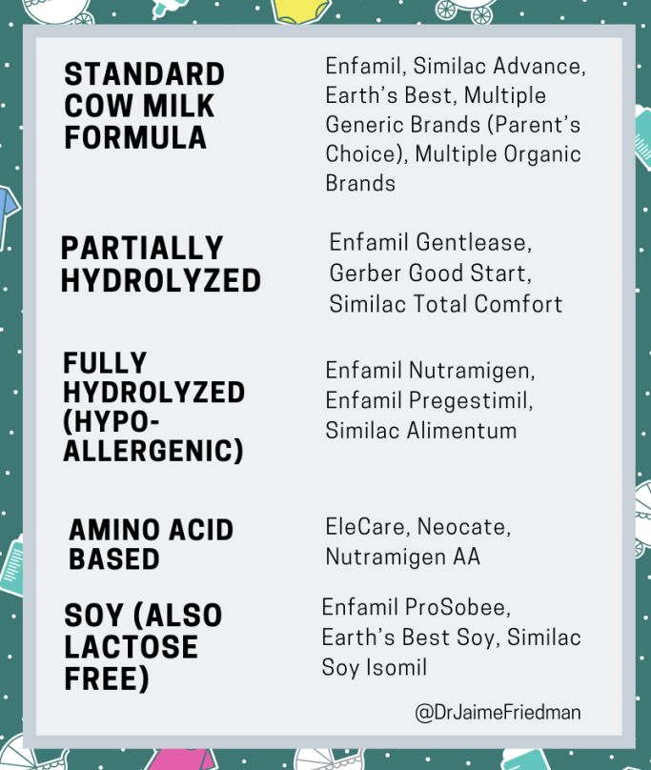
Infant formulas have 20 calories in each ounce
Three types of formula;
  Ready-to-feed formula is available in a can or carton and should not be diluted.
  Liquid concentrated formula is formulated to be diluted with equal amounts of water.
  Powder formula should be dissolved in water.
VNSG 1577 NURG Care 1 Wk 3
Notes:
Cost of formula: cost depends on type, brand, use (premature infant, lactose intolerance, hypo-allergenic, etc..)

Slide 30

Bottle-Feeding Problems
Parents should be warned about the following practices that are not healthy or safe for the infant:
• Infant cereal fed through a bottle increases the risk of choking.
• Water or fruit juice given before 6 months of age does not meet the calorie and nutritional needs of the infant.
• Overdiluting the formula to reduce expense decreases the calorie content and reduces the nutritional value of the formula.
• Formula mixed with private well water that has not been tested for safety
• Allowing a baby to sleep with a bottle in the crib
VNSG 1577 NURG Care 1 Wk 3

Slide 31
Infant Nutrition
0-12 months
Rapid growth
birth wt doubles in 4-6 months and triples by I year of age.
Breastfeeding is recommended as a major source of nutrition
Infant formula, if not breastfed (NO COW’S MILK)
  Need generous supply of all nutrients:
    Kcal, protein, calcium, iron
VNSG 1577 NURG Care 1 Wk 3
Notes:
Kcal: The term used to represent the amount of energy required to raise the temperature of a liter of water one degree centigrade at sea level. In nutrition terms, the word calorie is commonly used to refer to a unit of food energy.
Box 16.1
Calorie and Fluid Requirements of the Newborn
Estimated calorie requirements
Term infant: 105 to 108 kcal/kg/day
Preterm infant: 110 to 120 kcal/kg/day
Estimated fluid requirements
Term infant: 140 to 160 mL/kg/day
Preterm infant: 60 to 80 mL/kg/day

Slide 32
Infant Nutrition (0-12 months)
Solid food introduced at 4-6 months
Started on cereal (iron fortified)
Introduce new foods one at a time
May start eating vegetables, fruits, meats, eggs
Watch food consistency– choking!!
NO HONEY!!: infantile botulism
IRON, IRON, IRON, IRON---lose fetal supply at 5-6 months
VNSG 1577 NURG Care 1 Wk 3
Notes:
Ex: Poly Vi Sol supplemental vitamins: Breastfed infants need additional Vitamin D for bone strength and growth, prevent rickets. Iron to prevent iron deficient anemia
Slide talks about needing to supplement iron. Most infant foods like cereals, baby foods etc are fortified.

Slide 33
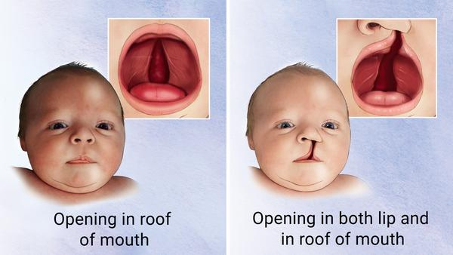
Cleft Lip/ Cleft Palate
Cleft palate is a common birth condition. It can occur alone or as part of a genetic condition or syndrome.
Symptoms arise from the opening in the mouth. They include difficulty speaking and feeding.
Surgery restores normal function with minimal scarring. If needed, speech therapy helps correct speaking difficulties.
Surgery typically not performed until between 9 months and 1 year. Allows to palate to expand and change as the baby grows. suck weakly and need a special bottle to feed.
Support from a feeding therapist, certified lactation consultant, and/or nurse experienced in feeding children with cleft palate is recommended for parents.

Slide 34
Childhood Nutrition (1-5 years)
Preschoolers
Finger foods = independence
Avoid rewarding or comforting with foods
Don’t make mealtime a struggle
Snacks should be planned to augment nutritional intake
Provide nutrient rich foods
VNSG 1577 NURG Care 1 Wk 3

Slide 35
Childhood Nutrition (1-5 years)
Preschoolers
  Slower growth rate
  Tend to have erratic & ritualistic eating patterns
  Picky eaters with strong food preferences
  Decreased calories BUT increased protein
  Interest goes from food to fun
  16 oz milk – should use whole milk until 2 yrs old
VNSG 1577 NURG Care 1 Wk 3

Slide 36
Childhood Nutrition (6-10 years)
School age
  Slow, steady growth
  Increased appetite – good eaters!
  Breakfast important!
  Dental health important
  Regular exercise important
  Involve in obtaining & preparing food
  Gardening activities
  Learn good eating habits
  Nutrient stores for puberty are being made
  May see increase in weight
  Use MyPlate to plan meals
VNSG 1577 NURG Care 1 Wk 3
Notes:
You can google “My Plate” Used to be a pyramid. Now its an actual plate divided out.

Slide 37
Adolescent Nutrition (11-18 years)
  Growth spurt at puberty
    May see decrease in weight
  2000-3000 kcal/day
  45-60 grams protein/day
  Calcium, iron important
  Dietary influences:
    Peers
    Activity level
    Body image
    Independence
VNSG 1577 NURG Care 1 Wk 3
Notes:
May see a decrease, but also could see increase. Depending on diet and activity level.

Slide 38
Adult Nutrition (18-64 years)
  Energy needs decline but intake often does not.
  Pregnancy & Lactation may alter nutritional needs (see Nutrition & Pregnancy)
  Factors that may affect nutrition:
    Stress
    Occupational influences
    Lifetime dietary habits
    Exercise & activity requirements
VNSG 1577 NURG Care 1 Wk 3

Slide 39
Geriatric Nutrition (65 + years)
  Physiological changes
    Decreased BMR = need to reduce calories (in the absence of disease & illness)
    Increased need for calcium
    Fewer taste buds—takes more salt to make it taste good
    Loss of teeth due to periodontal disease
    Slowing of peristalsis—constipation
    Decreased sense of smell
    Decreased sensation of thirst
VNSG 1577 NURG Care 1 Wk 3
Notes:
With the fewer or altered taste buds, foods may require more seasoning. Try to avoid salt if they have cardiac issues. But good substitutes are like salsas, Mrs. Dash, seasoning rubs or blends for meats. Etc.

Slide 40
Geriatric Nutrition (65 + years)
Limited Income recommendations
  Generic brand foods, coupons
  Substitute products
  Avoid convenience foods
  Buy on sale & freeze
  Utilize community resources & nutrition programs
Economic/Social influences:
  Fixed income
  Loss of spouse, friends, mobility, self-esteem, eating problems
  May be dependent on others to prepare food or shop for them
  Transportation source
  Targets of fads & quacks
  Medications alter appetite
VNSG 1577 NURG Care 1 Wk 3

Slide 41
Geriatric Nutrition (65 + years)
Difficulty chewing
  Leads to nutritional deficiencies in:
    fiber,
    Vitamins A & C
    minerals
What to recommend:
  Encourage regular visits to the dentist
  Have dentures repaired, refitted, replaced
  Chop fruits, veggies finely: shred green leafy veggies: select ground meat, fish, poultry
  NO steak!
VNSG 1577 NURG Care 1 Wk 3

Slide 42
Geriatric Nutrition (65 + years)
Lowered Glucose Tolerance:
  Eat more complex CHO:
    Breads, cereals, rice, pasta, potatoes, legumes
    Limit simple sugars
Decreased social interaction:
  Loneliness as a result
    Meals on wheels
    Senior center
    Make a day a week of eating with family
Loss of Appetite, Sense of Smell & Taste
  Eat essential nutrient rich dense foods
  Find ways to make meals appealing
  Eat small meals frequently with nutritious calories
VNSG 1577 NURG Care 1 Wk 3

Slide 43
Geriatric Nutrition (65 + years)
Planning:
  Light meals – easy to digest!
  Well balanced: iron, calcium, fiber, less fat
  Calories to fit needs:
  Respect individual preferences
  Encourage them to eat with others if possible
VNSG 1577 NURG Care 1 Wk 3

Slide 44
Obesity
Obesity is caused by a caloric intake that exceeds energy expenditure. Having a large waist results in an apple-shaped body.
This is associated with greater health risks, especially for heart disease and cancer.
The metabolic activity increases substances such as triglycerides, low-density lipoprotein (LDL) cholesterol, and serum glucose that contribute to health risks.
Being overweight or obese results from eating more calories than you use each day.
Obesity is measured by many scales, most commonly through measurement of the body mass index (BMI).
Those whose BMI is between 25 and 29.9 are overweight, and those with a BMI of 30 or greater are classified as obese.
VNSG 1577 NURG Care 1 Wk 3
Notes:
Page 638 Med Surg text
Factors such as gender, age, body frame size, and being an athlete with larger muscle mass can influence these measurements

Slide 45
Malnutrition
Malnutrition occurs when the body doesn't get enough nutrients. Causes include a poor diet, digestive conditions, or another disease.
Those whose BMI less than 18.5
Symptoms are fatigue, dizziness, and weight loss. Untreated malnutrition can cause physical or mental disability.
Treatment must address any underlying conditions and replace missing nutrients.
VNSG 1577 NURG Care 1 Wk 3
Notes:
I know we’ve talked about this before. But amenorrhea is a side affect of malnutrition in females.

Slide 46
Nutrition & Cultural Considerations:
If the patient is unfamiliar with the food being served in the hospital and is unable to eat/refusing to eat:
  Encourage the family to bring in food from home that the client is familiar with.
  The best approach to assisting a client to change eating behaviors is to relate changes to individual culture and lifestyle.
VNSG 1577 NURG Care 1 Wk 3
Notes:
Page 618 Med Surg text
Cultural Nutritional Assessment
Questions to ask when performing a cultural nutritional assessment:
What types of foods are common in your culture or community?
What are your preferred foods?
Which foods do you most commonly consume?
How and where are your foods chosen and purchased?
Who prepares the food in your household?
Who purchases the food in your household?
How is your food stored for future use?
How is your food prepared before being eaten?
What foods do you eat or avoid to maintain your health?
What foods do you eat or avoid when you are ill?

Slide 47
Serving Food
Assist the client as needed
  First, SIT THEM UP
  Take to Bathroom
  Glasses, dentures
  Wash hands, face, do oral hygiene
Check each tray with diet order, check utensils, food on tray, condiments being served
  Especially be aware if they are NPO
Check the client’s name band, allergy bracelet
VNSG 1577 NURG Care 1 Wk 3

Slide 48
Serving Food
Serve hot food hot, & cold foods cold
Fill bowls & glasses ¾ full
No large quantities
Be pleasant
Open cartons, packages, & cut up meat if necessary
Check on the client periodically & if not eating determine the reason
Note how much food the client ate, liquid drank, & document!
  Document fluids in mls
VNSG 1577 NURG Care 1 Wk 3
Notes:
One of the biggest complaints we see in the nursing home, is that the food is never warm enough. When they eat in the dining room its not as big of an issue. For those who prefer to eat in their rooms, it’s a huge complaint.

Slide 49
Stimulating Appetite
Assess the cause-eliminate the reason
Small frequent meals, attractive, small servings
Pt choice of foods-bring from home
Seasoning to taste
Liquid supplements
Exercise throughout day
Oral hygiene before meals
Sitting position for eating
Pain medication
Appetite stimulants
VNSG 1577 NURG Care 1 Wk 3
Notes:
An example of an appetite stimulant would be marinol, megace. Marinol is derived from cannabis plants. Comes in pill form. Megace is usually a liquid.

Slide 50
Assistance with Feeding
*REQUIRED BY THE CONFUSED, VERY YOUNG, HELPLESS, SICK OR IMMOBILE
  Wash hands
  Provide comfort measures
  Provide napkin or towel
  Arrange tray
  Do not rush!!
  Sit down & visit
  Use a spoon & a straw for liquids-shorten the straw
  Give small bites
VNSG 1577 NURG Care 1 Wk 3

Slide 51
Assistance with Feeding
Alternate food with liquid, especially if dry food
Ask how he or she likes to eat or in what order
Warn them of possible hot or cold
Straw for soup
Wipe chin/face as needed
  Don’t scrape food off face with a spoon
Allow client to do as much as possible
Record intake
VNSG 1577 NURG Care 1 Wk 3

Slide 52
Dentition
Poor nutrition can lead to all kinds of health issues, including oral health problems such as gum disease and cavities.
Studies show that people who have lost teeth or wear dentures don't eat as many fruits or vegetables and tend to have less nutritious diets overall.
What you put in your mouth impacts not only your general health but also the health of your teeth and gums.
VNSG 1577 NURG Care 1 Wk 3
Notes:
https://www.mouthhealthy.org/en/adults-40-60/nutrition

Slide 53
Dysphagia
Difficulty swallowing
Causes of Dysphagia
  Poor, loose-fitting teeth
  Presence of artificial tubes ex NG tube, tracheostomy
  Paralyzed vocal cords
  Tumor in mouth, throat, or esophagus
  Surgery to head, neck, or esophageal areas
  Neuromuscular disorders ex. CVA
VNSG 1577 NURG Care 1 Wk 3

Slide 54
Dysphagia
Symptoms
Drooling
Feeling that food is sticking in throat during or after meal
Sensation of a “lump” in the throat
Weight loss
Poor nutritional intake
Choking and coughing with eating
Frequent respiratory infections (aspiration pneumonia)
VNSG 1577 NURG Care 1 Wk 3

Slide 55
Dysphagia
Assisting Clients with Dysphagia
Have suction equipment available
Assist to sitting position
Oral hygiene before feeding
Semi solids with some texture
Quarter size bites
Observe for swallowing
Tuck chin; remind to swallow 2-3 times
Check mouth for food or fluids still in oral cavity
Keep sitting with HOB 30 degrees after meals
Watch for coughing and choking
ALWAYS PLACE FOOD ON THE UNAFFECTED SIDE
VNSG 1577 NURG Care 1 Wk 3

Slide 56
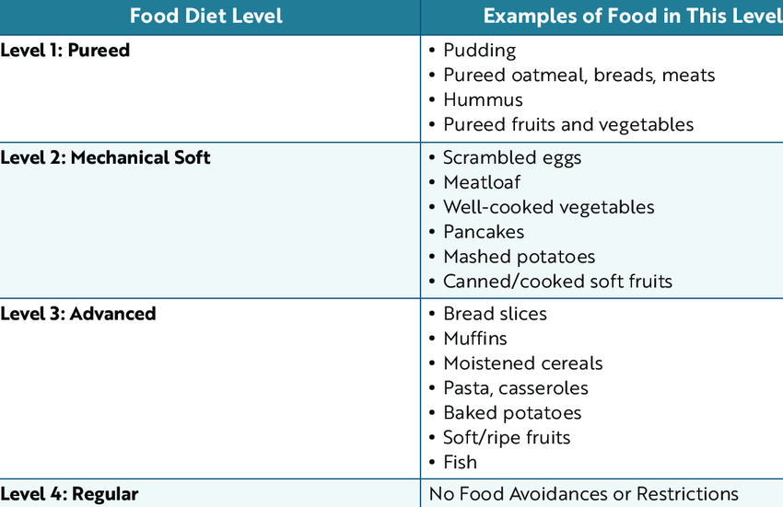
Notes:
Mechanical Soft is chopped up super fine usually. Can have meats, but want them chopped up really well. Usually will use like an electric food chopper. Want it moist, not dry,

Slide 57
Alterations in nutritional intake
Hospitalized patients often have
  Meals delayed
  N/V
  Pain
  Procedures/Diagnostic tests/Labs
  Surgery
VNSG 1577 NURG Care 1 Wk 3

Slide 58
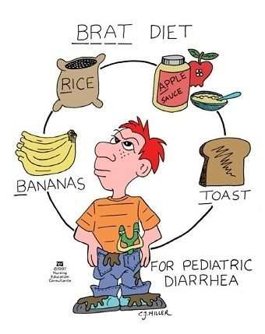

Slide 59
Intestinal Gas
Nursing Interventions:
  Increase fiber slowly
  Note any milk tolerances
  Prevent constipation
  Identify problematic foods
  Ambulate
  Eat slowly, chew better
  No straws, no gum
  Avoid carbonated beverages
VNSG 1577 NURG Care 1 Wk 3

Slide 60
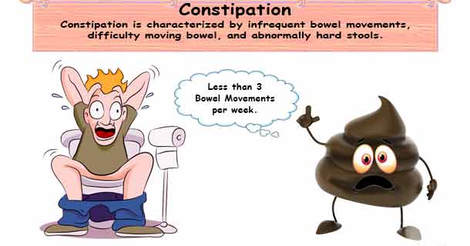

Slide 61
Constipation
Stools hard difficult to pass
Can lead to very serious problems
Prevention
  Fluid
  Fiber
  Ambulation
  Relax
  Follow routine
  Avoid laxatives
  DO NOT put off the urge-#1 cause of constipation
VNSG 1577 NURG Care 1 Wk 3

Slide 62
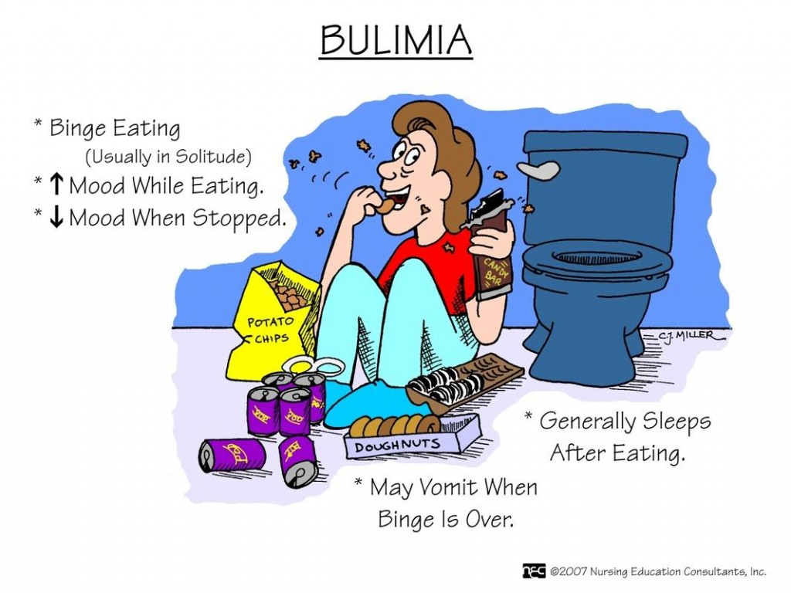

Slide 63
Nutrition Therapy for Eating Disorders
Bulimia
Binge eating & purging
Electrolyte imbalances
Allow to eat enough to satisfy hunger
Serve food warm (increased satiety)
Sit down meals (no finger foods)
Increase bulk (whole grain, high fiber)
Regular mealtimes
VNSG 1577 NURG Care 1 Wk 3

Slide 64
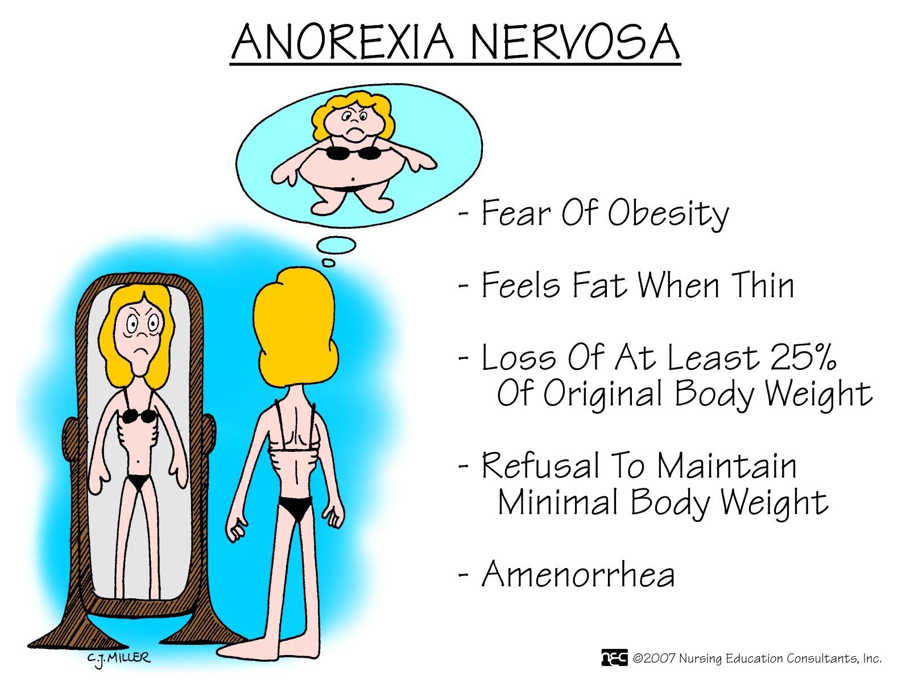

Slide 65
Nutrition Therapy for Eating Disorders
Anorexia
Anorexia Nervosa
Lack or loss of appetite
Cancer,
Chemotherapy, Post op
Viral illness,
SOB
Psych disorder
Do not even want food-food aversion
Altered body image-see self as fat
Don’t encourage them
Increase food intake gradually
Small frequent meals
VNSG 1577 NURG Care 1 Wk 3
Notes:
Page 637 Med Surg text

Slide 66
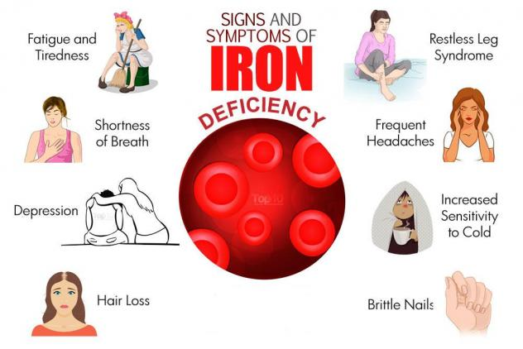
Iron Deficiency Anemia
VNSG 1577 NURG Care 1 Wk 3

Slide 67
Iron Deficiency Anemia
Patho | Vitamin B12 (cobalamin) is essential for the production of hemoglobin and GI absorption. Iron-deficiency cause of low RBC production (anemia). Prenatal – developmental delays in fetus Older adults – decrease gastric acid secretions impair absorption of iron, B12, protein
Manifestations | Fatigue, shortness of breath, depression, hair loss, restless leg syndrome, frequent headaches, increased sensitivity to cold, brittle nails, pallor, mouth fissures, inflamed tongue. Children & Older adults – poor nutritional intake Immunocompromised
Diagnosis | Hemoglobin, Hematocrit, Reticulocyte count (retic), Serum iron, ferritin, TIBC (total iron-binding capacity)
Treatment | Iron supplements – Vitamins (child – poly vi sol drops) - (adult – B12 oral, injections, IV ) Dietary intake: green leafy vegetables, nuts, seeds, meats, fish, beans Nutritional consult
Nursing Care | Teach patients to include adequate amounts of dietary and supplemental intake of iron. Iron supplements should be taken with Vitamin C to enhance absorption Dental hygiene practices
VNSG 1577 NURG Care 1 Wk 3
Notes:
Page 497-498 Med Surg text

Slide 68
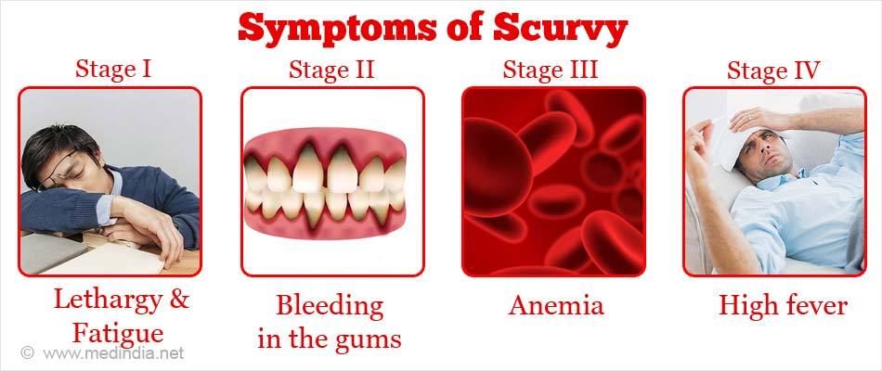

Slide 69
Scurvy – Vitamin C deficiency
Patho | A condition caused by a severe lack of vitamin C or ascorbic acid in the diet. Lack of fruits and vegetables in daily diet Anorexia or illness causing anorexia Diet allergies Poor diet
Manifestations | Bruising, bleeding gums, weakness, fatigue, and rash, skin roughness, poor wound healing, iron deficiency anemia
Diagnostics / Labs | CBC (anemia), Vitamin def labs, Liver function, kidney (BUM / Creat)
Treatment | Vitamin C supplements Diet including citrus fruits, potatoes, broccoli, and strawberries. Multivitamins
Nursing Care | Solid history, assessment, diet history, medical conditions (potential causes)
VNSG 1577 NURG Care 1 Wk 3
Notes:
Scurvy—a potentially fatal medical condition caused by vitamin C deficiency—is not common. Children who develop scurvy experience the same symptoms that affect adults. Children with scurvy are usually also prone to failure to thrive, which is a condition characterized by a lack of physical growth, and impaired cognitive and social development.
If left untreated, scurvy can cause serious health issues that manifest with fever, jaundice, open wounds, multi-organ dysfunction, and may eventually lead to death.
the Royal Navy made sure that all sailors had lemon juice or lime juice to drink when they were at sea for longer than one month. The sailors thought that it was the acid content of the lemon juice that cured scurvy (vitamin C is also called ascorbic acid). American sailors started calling British sailors Limeys back in the late 1880’s 90’s. Was popularized again during WWII.

Slide 70
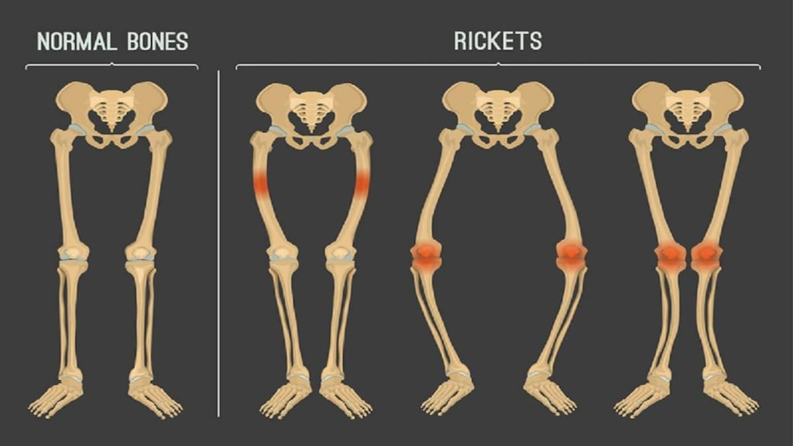
Rickets – Vitamin D deficiency
VNSG 1577 NURG Care 1 Wk 3

Slide 71
Rickets – Vitamin D deficiency
Patho | A softening and weakening of bones in children, usually due to inadequate vitamin D. inability to absorb Vit D due to liver / kidney disease. Calcium deficiency. Malnutrition, low sunlight exposure
Manifestations | Symptoms include delayed growth, bow legs, weakness, and pain in the spine, pelvis, and legs. Poor growth and development (short height, low weight) Knock knees, curvature of the spine, susceptible to bone fractures Muscle spasms, pelvic, spinal or cranial bone deformities
Diagnosis | Vitamin deficiency labs (ADEK), liver function, kidney (BUN / Creat), Albumin, CMP, CBC, phosphate Xrays of bone structures
Treatment | Pregnant mothers: eating well balanced diet, prenatal vitamins Positioning or bracing – correcting bone deformities Orthopedic surgery – bow legs and knock knees
Medications Nutrition | Vitamin D supplements, Calcium supplements, Phosphate supplements (hereditary rickets) Vit D: fish, liver, milk, eggs Calcium: milk, yogurt, cheese, leafy green vegetables Phosphorus: meats, poultry, fish, nuts, beans, dairy
VNSG 1577 NURG Care 1 Wk 3
Notes:
Its pretty uncommon. In the US there are less than 20,000 cases per year.
It can also be caused by an undiagnosed liver or kidney disease. Or it could be an absorption issue, like cystic fibrosis, celiac disease or inflammatory bowel disease.
Good prenatal care and well child check ups are what catch these things early on.

Slide 72
PKU - Phyenylketonuria
Rare inherited disorder that causes an amino acid called phenylalanine to build up in the body. PKU is caused by a defect in the gene that helps create the enzyme needed to break down phenylalanine.
Without the enzyme necessary to process phenylalanine, a dangerous buildup can develop when a person with PKU eats foods that contain protein or eats aspartame, an artificial sweetener. This can eventually lead to serious health problems.
For the rest of their lives, people with PKU — babies, children and adults — need to follow a diet that limits phenylalanine, which is found mostly in foods that contain protein.
Babies in the United States and many other countries are screened for PKU soon after birth. Recognizing PKU right away can help prevent major health problems.
Notes:
This is what they are testing for when they prick the newborns heel. They can also use that blood to screen for other issues. But PKU is the primary.

Slide 73
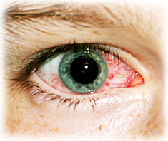
Xerophthalmia
Xerophthalmia is a disease that causes dry eyes due to vitamin A deficiency. If it goes untreated, it can progress into night blindness or spots on your eyes. It can even damage the cornea of your eye and cause blindness.
This disease is rare in the U.S. It’s more commonly seen in developing countries, where people are more likely to have nutrient deficiencies. It can be treated with vitamin A supplements.

Slide 74
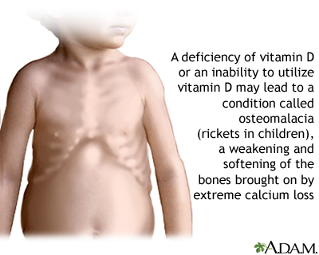
Osteomalacia
Osteomalacia is softening of the bones. It most often occurs because of a problem with vitamin D, which helps your body absorb calcium. Your body needs calcium to maintain the strength and hardness of your bones.
In children, the condition is called rickets
A lack of the proper amount of calcium in the blood can lead to weak and soft bones. Low blood calcium can be caused by low vitamin D level in the blood.

Slide 75
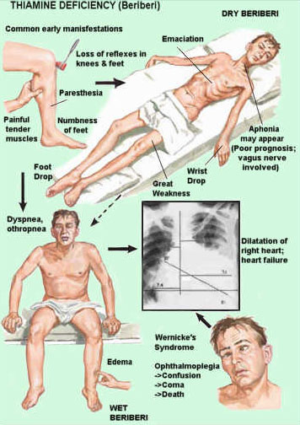
Beriberi – A Vitamin B1 (Thiamine) deficiency.
Notes:
Pretty rare, less than 200,000 cases every year. A lot of our foods like breakfast cereals and breads are already enriched. You see this more with people who abuse alcohol. Heavy drinkers usually have poor nutrition. Excess alcohol makes it harder to the body to absorb and store B vitamins.
This disease is more common in regiions of the world where the diet includes unenriched, processed white rice which only has a tenth of the amount of thiamine as brown rice.
Its treated with supplements, probably thiamine injections or even IV thiamine. They’ll keep doing blood work to check levels. If its alcohol induced, they may make you go to rehab before doing anything else.

Slide 76
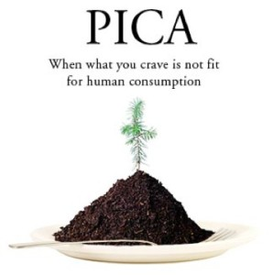
Dangers of PICA

Slide 77
PICA – eating disorder
Patho | Eating disorder involving eating items that are not for human consumption or nutritional value.
Manifestations | Anemia, potential intestinal blockages, toxic side effects (lead in paint, bacteria or parasites) Iron-deficiency anemia & malnutrition: 2 most common causes followed by pregnancy Body is trying to correct a significant nutrient deficiency Occurs with mental health disorders ie: intellectual disability, autism, schizophrenia, trichotillomania (hair-pulling disorder), excoriation (skin-picking) disorder Can affect children, adolescents and adults of either gender
Diagnostics / Labs | No lab tests for PICA – Dx is made from clinical history Iron-deficiency labs Vitamin deficiency labs
Treatment | First-line treatment – mineral or nutrient deficiencies correction Vitamins, food nutrients, mental health counseling
Nursing Care | Nutritional, mental health counseling consultations
VNSG 1577 NURG Care 1 Wk 3
Notes:
Other substances: paper, soap, cloth, hair, string, wool, soil, chalk, talcum powder, paint, gum, metal, pebbles, charcoal, ash, clay, starch, or ice.
Pica | National Eating Disorders Association

Slide 78
Nutrition
The Nursing Process:
Focus Assessment
VNSG 1577 NURG Care 1 Wk 3

Slide 79
Subjective Assessment
Weight
Use ht/wt chart
20% above or below
10% UNINTENTIONAL loss
At risk: Ca, alcoholic, elderly, surgery, traumatic injury
Appetite
Altered smell or taste
Disease state
Sore mouth, tooth pain
Food intolerances and allergies
Dysphagia
Difficulty swallowing, oral health
Indigestion
  When, character of discomfort, what relieves it
VNSG 1577 NURG Care 1 Wk 3

Slide 80
Subjective Assessment
Bowel functioning
  COCA
  Constipation, gas, diarrhea
Lifestyle
  Food preferences, cultural/religious
  Money, living conditions, who cooks
  Safe food preparation
Medications
  Diuretics, MAO inhibitors
  Timing of medications and meals
  OTC supplements
VNSG 1577 NURG Care 1 Wk 3
Notes:
COCA: Color, Odor, Consistency, Appearance (stools)

Slide 81
Subjective Assessment
Family History
  Obesity, allergies, CV, diabetes, thyroid
Medical History
  GI, oral problems, cancer, eating disorders, AIDS, alcoholism, therapeutic diets, age, surgery, burns, injuries
Diet History
  Therapeutic diet
  24 hour recall
VNSG 1577 NURG Care 1 Wk 3

Slide 82
Objective Assessment
Alert, responsiveness
B vitamin deficiencies, thiamine, alcohol
Anthropometric measurement
Skin fold measurements, height
Daily weight –same time every day
Mid-arm circumference-muscle wasting
Elbow breadth, wrist circumference-body frame
Posture, muscle tone, skeletal deformities
Protein, calcium, Vit D def
Vital signs
B/P down, pulse up = dehydration
B/P up, pulse down= over hydration
VNSG 1577 NURG Care 1 Wk 3

Slide 83
Objective Assessment
Hair
  Dull, dry, brittle, thin-protein deficit
  Hair loss-excessive Vit A, protein deficit
Skin, nails
  Dry scaly, wound healing, nails brittle, fragile
  Protein, Vit E, Zinc, Calcium, Pellegra
Oral mucous membranes, tongue
  Cheilitis-Glossitis-Gingivitis
  B complex deficiency
VNSG 1577 NURG Care 1 Wk 3
Notes:
Pellagra is a disease caused by a lack of the vitamin niacin. Symptoms include inflamed skin, diarrhea, dementia, and sores in the mouth. Areas of the skin exposed to either sunlight or friction are typically affected first. Over time affected skin may become darker, stiffen, peel, or bleed.

Slide 84
Nutrition
Nutritional Support Methods:
Oral Feeding &
Therapeutic Diets
VNSG 1577 NURG Care 1 Wk 3

Slide 85
INFLUENCES ON NUTRITION
Ethical & Cultural beliefs
  animal rights, cultural groups, ethnicity
Only eat organic foods
Economic restraints
Peer pressure-parties
Advertising-temptation
Convenience-busy
VNSG 1577 NURG Care 1 Wk 3

Slide 86
Regular Diet
Used for clients who do not need dietary restrictions or modifications.
VNSG 1577 NURG Care 1 Wk 3

Slide 87
Types of Nutritional Support Methods
Oral Feeding
      Includes various therapeutic diets & oral supplements
Tube Feeding
        Nasogastric
        Orogastric
        Enterostomy
Parenteral Nutrition
    Total Parenteral Nutrition (TPN)
    Peripheral Parenteral Nutrition (PPN)
VNSG 1577 NURG Care 1 Wk 3

Slide 88
THERAPEUTIC DIET CONSIDERATIONS
Considerations for those who need a special diet:
  Disease process
  Social & religious considerations
  Patient’s dislikes and likes
  Allergies
  Client’s condition
  Purpose of diet and consequences of not following
Must make it “work” for the individual
VNSG 1577 NURG Care 1 Wk 3

Slide 89
Reasons for a Therapeutic Diet
Increase or decrease body wt by manipulating kcal (energy)-anorexia/obesity
Reduce or prevent edema by limiting fluid/salt-CHF
Aid in digestion by avoiding foods that irritate the GI system-IBS, PUD, GERD
Eliminating a food that the body is unable to tolerate-Gall bladder, lactose
VNSG 1577 NURG Care 1 Wk 3
Notes:
IBS- Irritable Bowel Syndrome
PUD – Peptic Ulcer Disease
GERD- Gastroesophageal Reflux Disease

Slide 90
Reasons for a Therapeutic Diet
Help overburdened organ(s) regain normal function-liver, kidney disease
Slowing overactive digestion-dumping syndrome
Regulate amount of food constituents in disorders of metabolism-Diabetes, PKU
VNSG 1577 NURG Care 1 Wk 3

Slide 91
Preparing a Patient for a Therapeutic Diet:
Discuss allowed & prohibited foods
Explain reasons why food labels are important
  Teach how to read
Include significant other or family
  Who does the cooking?
Refer to dietician or diet manual
Explain the consequences of not following the therapeutic diet
VNSG 1577 NURG Care 1 Wk 3

Slide 92
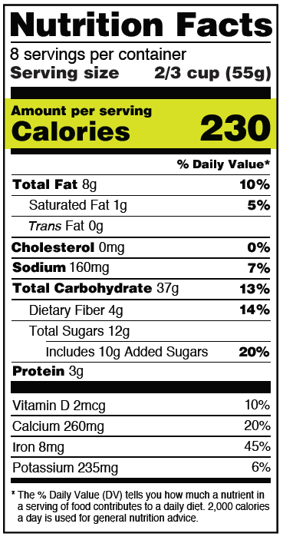
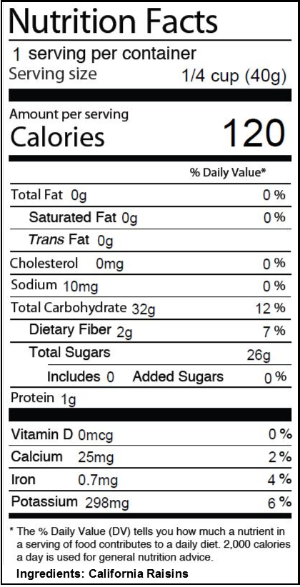
Reading Nutrition labels
Figure 23.1
VNSG 1577 NURG Care 1 Wk 3

Slide 93
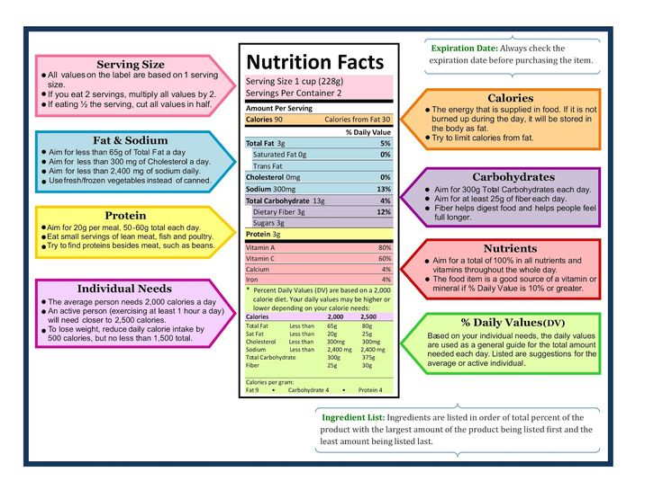
VNSG 1577 NURG Care 1 Wk 3

Slide 94
Helping A Patient Accept A Therapeutic Diet
Table 24.1
Clarify misinformation
Individualize
Difficult to change food attitudes
  MORE LIKELY TO CHANGE EATING HABITS IF THEY UNDERSTAND THE RELATIONSHIP B/T THE DIET & THEIR DISEASE
VNSG 1577 NURG Care 1 Wk 3
Notes:
If you explain to someone why they need to do something or make a change, they are much more likely to accept and adhere to it. If you just say, do it because your dr. said so. Its not received as well.

Slide 95
Therapeutic Diets:
Altered Consistency
Clear Liquid Diet
A progressive diet
  Easily absorbed: do not over-stimulate the digestive tract
  Liquid at room temperature
  Purpose:
    Provide an oral source of fluids, small amounts of calories, & electrolytes
    Fiber free and fat free
    Prevent dehydration
    Reduce colonic residue
    Relieve extreme thirst
VNSG 1577 NURG Care 1 Wk 3

Slide 96
Clear Liquid Diet
Composition:
  Clear “see-through” foods
  bouillon, broth, Tea, coffee
  Clear fruit juices: cranberry, apple, grape—No OJ or prune
  Jell-O
  Carbonated beverages
  Popsicles
  Honey, sugar, gumdrops, lemon for tea
VNSG 1577 NURG Care 1 Wk 3

Slide 97
Clear Liquid Diet
Concerns:
  Monitor client tolerance to oral intake
  NOT NUTRITIONAL!!
  ONLY ADEQUATE FOR A 3-5 DAY MAXIMUM
  Very few to no vitamins, proteins, or nutrients
  Consider the diabetic clear liquids-no calories
VNSG 1577 NURG Care 1 Wk 3

Slide 98
Therapeutic Diets: Altered Consistency
Full Liquid Diet
Considered a transition or progressive diet
  Liquids that can be poured at room temp
  Purpose:
    Provide oral nourishment (water, calories, protein, vitamins, minerals & dairy products)
    Easily swallowed (except after a CVA)
    If use for > 3 days, must provide supplements
VNSG 1577 NURG Care 1 Wk 3

Slide 99
Full Liquid Diet
What’s for dinner?
  Any clear liquid
  Soups (creamed or strained)
  Milk, creams
  Sherbet, plain ice cream, yogurts
  All cooked cereal
  Custard, pudding, eggnog
  Vegetable & strained fruit juice
  All prepared liquid formulas
  *Lactose-intolerant clients may need lactose-free liquids
VNSG 1577 NURG Care 1 Wk 3

Slide 100
Full Liquid Diet
Concerns:
  Monotonous: dull, repetitious; lacking in variety and interest.
  Can be nutritionally inadequate
  Monitor for tolerance of feeding
  Diabetic—must be sugar free
VNSG 1577 NURG Care 1 Wk 3

Slide 101
Therapeutic Diets:
Altered Consistency
Pureed Diet
For clients who are unable to chew or swallow
It can be used as a long-term diet
Seasoning depends on individual client preferences
Typically, no raw eggs, nuts, whole breads, raw fruits or vegetables
No foods containing seeds
* Do not alter food any more than necessary
VNSG 1577 NURG Care 1 Wk 3

Slide 102
Therapeutic Diets: Altered Consistency
Dysphagia Diets
For clients at risk for aspiration
  Dysphagia Level 1-Pureed
  Dysphagia Level 2- Mechanical Soft
          Ground, minced meat
          Fork-mashable foods, fruits & Vegetables
  Dysphagia Level 3-Advanced (soft-solid)
          Easy-to-cut meats, fruits, vegetables
          No sticky foods, Crunchy vegetables or very dry foods
  Dysphagia Level 4- Regular Textures
  *Clients with dysphagia should be positioned at least 30-35 degrees for meals and should be closely monitored.
VNSG 1577 NURG Care 1 Wk 3

Slide 103
Dysphagia & Thickened Liquids
Patients with Dysphagia are at risk for aspiration.
Thickened liquids are provided for the management of dysphagia
Thin liquid consistencies can be aspirated into the airway.
Thin Liquids
Nectar-thick liquids (syrup)
Honey-thick liquids
Pudding-thick liquids
VNSG 1577 NURG Care 1 Wk 3
Notes:
A liquid diet is a diet that mostly consists of liquids, or soft foods that melt at room temperature. A liquid diet usually helps provide sufficient hydration, helps maintain electrolyte balance, and is often prescribed for people when solid food diets are not recommended, such as for people who suffer with gastrointestinal illness or damage, or before or after certain types of medical tests or surgeries involving the mouth or the digestive tract.
The Nectar Liquid Diet -- also known as the Nectar Thick Liquid Diet -- is not a weight loss diet plan, but rather a specialized nutrition plan for individuals that suffer from dysphagia, or difficulty chewing and swallowing food.
Honey thick liquids: Honey consistency means l liquids can still be poured, but are very slow. Some liquids will require a thickening agent to be added to reach honey consistency.
Pudding Thick liquids: liquid stays on a spoon in a soft mass but will not hold its shape. It pours slowly off a spoon and is sip-able. This consistency is difficult to draw though a wide-bore straw.

Slide 104
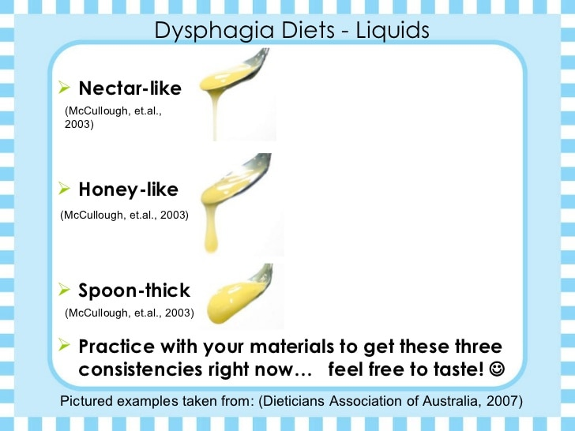

Slide 105
Therapeutic Diets:
Altered Consistency
Soft Diet (Bland Diet)
A modification of the Regular diet
“Soft” easy to digest foods that contain small amounts of seasoning
Easy to chew, digest and absorb
Moderate fiber content
Avoid:
    highly seasoned, fried, high fiber or any foods that may cause GI upset.
    Flatus causing foods
    No bran or unrefined grains
    No seeds, nuts, fresh fruit, coconut
    No spiced lunch meat
VNSG 1577 NURG Care 1 Wk 3

Slide 106
Soft Diet
Used for digestive problems
Purpose:
  Provide transition food between liquid & regular diet
  All nutrients provided
What’s for dinner? (fork-mash able foods)
  Macaroni
  Soft chicken, turkey, fish fillet
  Mashed potatoes
  Jell-O, custard pie, angel food cake
  Applesauce, ice cream, pudding
VNSG 1577 NURG Care 1 Wk 3

Slide 107
Therapeutic Diets:
Restrictive/ Modified Diets
Carbohydrate-Controlled Diets
  Considered for:
    Type I & II diabetics
    Gestational Diabetic clients
    Hypoglycemia (small frequent meals are needed to normalize blood sugar)
VNSG 1577 NURG Care 1 Wk 3

Slide 108
Principles of ADA Diet
All foods are placed in 1 of 6 exchange lists
Assigned a caloric intake
The client receives a certain kind & number of those exchanges at each meal & planned snacks
Carbohydrates 50-60% /day of total calories
Proteins 10- 20% /day of total calories
Fats- Lipid source of less than 30%
Recommended fiber intake 20-35 grams/day
Limit processed foods & concentrated sweets!
Diet must be individualized.
VNSG 1577 NURG Care 1 Wk 3

Slide 109
Principles of the ADA Diet
Exchange lists are foods in the list are assigned because they are similar in their protein, carb, fat, and calories.
  Milk
  Bread
  Meat
  Fruit
  Vegetable
  Fats
VNSG 1577 NURG Care 1 Wk 3

Slide 110
Therapeutic Diets:
Restrictive/ Modified Diets
Low-Residue Diet
Food items that minimize elimination pattern/reduce fecal volume
Avoid high fiber foods, milk & milk product
Avoid foods that may cause GI upset ex. Dumping syndrome
VNSG 1577 NURG Care 1 Wk 3

Slide 111
Therapeutic Diets:
Restrictive/ Modified Diets
Gastric Bypass Diet
Small frequent meals
Nutrient-dense meals
May need multi-vitamin supplements
Low fat/ High protein
Avoid carbonated drinks, simple CHOs, high residue foods
VNSG 1577 NURG Care 1 Wk 3

Slide 112
Sodium-Controlled Diets
Purpose:
  Diet restricted in sodium but contains essentials of good nutrition
  Hypertension
  Edema
  Renal disease
  Liver disease
  Congestive heart failure
VNSG 1577 NURG Care 1 Wk 3
Notes:
Sodium retains fluids – fluid retention creates extra work for the kidneys, liver and heart. Raises blood pressure which in turn stresses the kidneys, heart works harder, lungs are full of fluid, extremities are swollen. The goal is typically less than 2,000 mg of sodium a day.

Slide 113
High-Fiber Diet
Purpose:
  Promotion of regularity
  Maintaining normal bowel function & elimination pattern
  Creating mechanical stimulation of the GI tract (peristalsis)
  Treatment of constipation, hemorrhoids, diverticulosis
Principles
  High fiber foods & lots of fluid
  Foods high in complex CHOs & low in fat
  Examples: legumes, whole grains, fruits & vegetables
VNSG 1577 NURG Care 1 Wk 3

Slide 114
High Fiber Diet
What’s cooking?
  Fruits & vegetables
  Fruit juices
  Whole grain cereals, breads
  Does not exclude any food but encourage increased intake of high fiber foods & increase in fluid intake
VNSG 1577 NURG Care 1 Wk 3

Slide 115
Post Surgical Diets
Clear Liquid Diet
Full Liquid Diet
Soft Diet
Regular Diet
VNSG 1577 NURG Care 1 Wk 3
Notes:
Pg 125 Older Client Care text
Clear-liquid diet: foods that are liquid at room temperature and can be seen through. Ex: strained juices, teas, carbonated drinks (Sprite or GingerAle), clear broths, and gelatins
Full-liquid diet: foods that are clear-liquid with addition of foods that are not necessarily clear. Ex: custards, ice cream, milk, blended fruits and vegetables
Soft-diet: Includes foods from regular diet that have been modified for people who have difficulty chewing foods. Ex: mashed, chopped, or ground
Regular-diet: No special nutritional needs
Who orders these diets? So if a patient comes in through the ED and they are having abdominal pain. Its pretty site specific, they are getting admitted. The ED physician is lazy and just writes for diet as tolerated. You as the floor nurse receive that patient and realize, hey it’s a strong possibility that this person may be going to surgery later today or tomorrow. They might need to be made NPO. The surgeon will give orders for that.

Slide 116
Nutrition
Nutrition Support Methods:
Tube Feeding
VNSG 1577 NURG Care 1 Wk 3

Slide 117
Alternative Feeding Methods
IF THE GUT WORKS, USE IT!!
What if oral feeding is not possible?
  Formulas can be delivered to the GI tract
  (Enteral Feedings)
What if the gut doesn’t work?
  Glucose, amino acids, lipids can be delivered into the vascular system
  (Parenteral Nutrition)
VNSG 1577 NURG Care 1 Wk 3

Slide 118
Enteral Feedings
Feeding by way of the GI tract
Inability to take food orally
The patient must have a functioning GI tract
ADVANTAGES
  Less expensive
  Less risk for sepsis
  Maintain integrity of the intestinal mucosa
VNSG 1577 NURG Care 1 Wk 3

Slide 119
Enteral Feedings Methods
Nasogastric tube
Orogastric tubes
Enterostomy ex PEG
VNSG 1577 NURG Care 1 Wk 3
Notes:
PEG stands for percutaneous endoscopic gastrostomy. Use a scope to go in an place the tube in a very specific area.

Slide 120
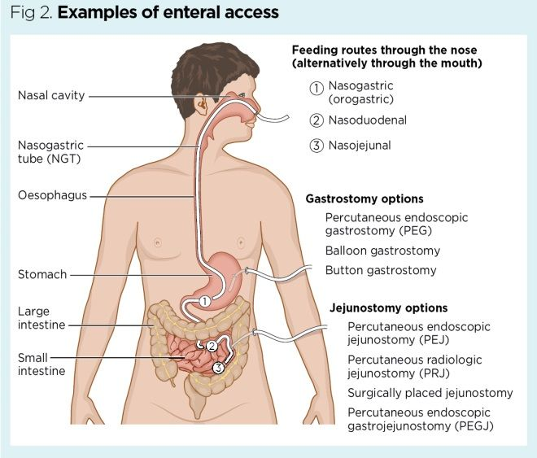
VNSG 1577 NURG Care 1 Wk 3
Notes:
Nasogastric (NG) tubes or Orogastric (OG) tubes are small tubes placed either through the nose or the mouth and end with the tip in the stomach. NG/OG tubes may be used for feedings, medication administration, or removal of contents from the stomach via aspiration, suction, or gravity drainage.
PEG: Percutaneous endoscopic gastrostomy - Tube is passed into a patient's stomach through the abdominal wall, most commonly to provide a means of feeding when oral intake is not adequate. This provides enteral nutrition despite bypassing the mouth; enteral nutrition is generally preferable to parenteral nutrition.
PEG tubes may also be extended into the small intestine by passing a jejunal extension tube through the PEG tube and into the jejunum via the pylorus.

Slide 121
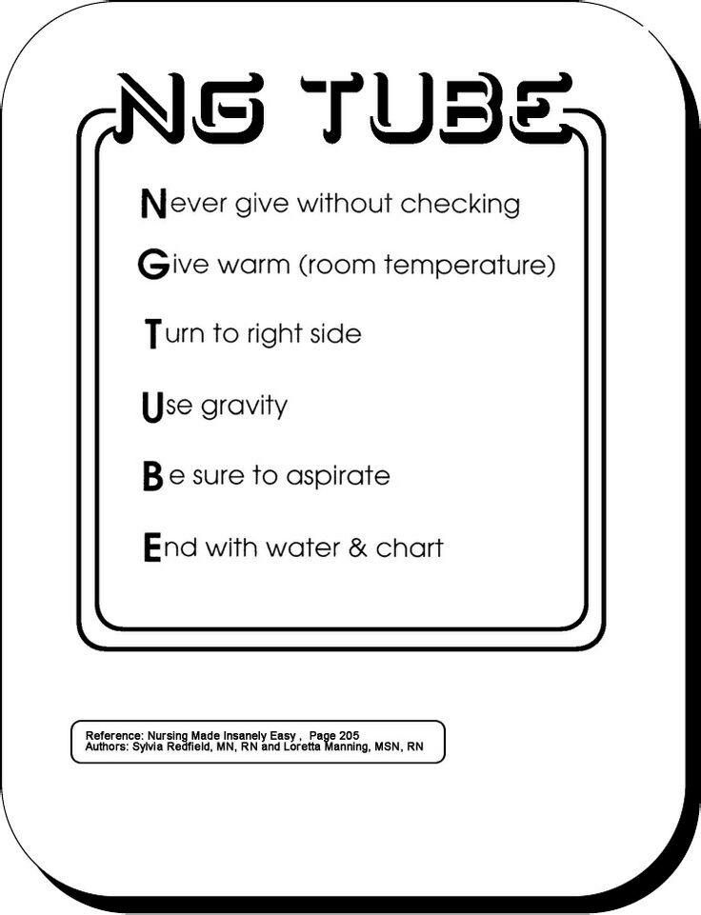
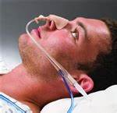

Slide 122
Foods High
In:
Protein
Fats
Potassium
Magnesium
Vitamin B’s
Vitamin D
Carbohydrates
Sodium
Valcium
Vitamin A
Vitamin C
Vitamin E
Please go over these and know which foods fall into which categories!

Slide 123
Test Hints!
Anemia – is there more than one kind? What does it look like?
Immunization Schedules – Pediatric and Adult. How long are certain immunizations good for? Ex: How many years is a tetanus or pneumococcal vaccine good for?
Vectors
Major Bacteria’s and where you typically see them. Ex: UTI’s? Central Lines?
Serum Sickness
Blood Transfusions
Different types of Isolation Precautions
Different types of fluid drainage and what it looks like? Ex: serous, serosanguinous, purulent?
Enteral feeding types
Types of Immunity
Types of Diets

